Slide 1
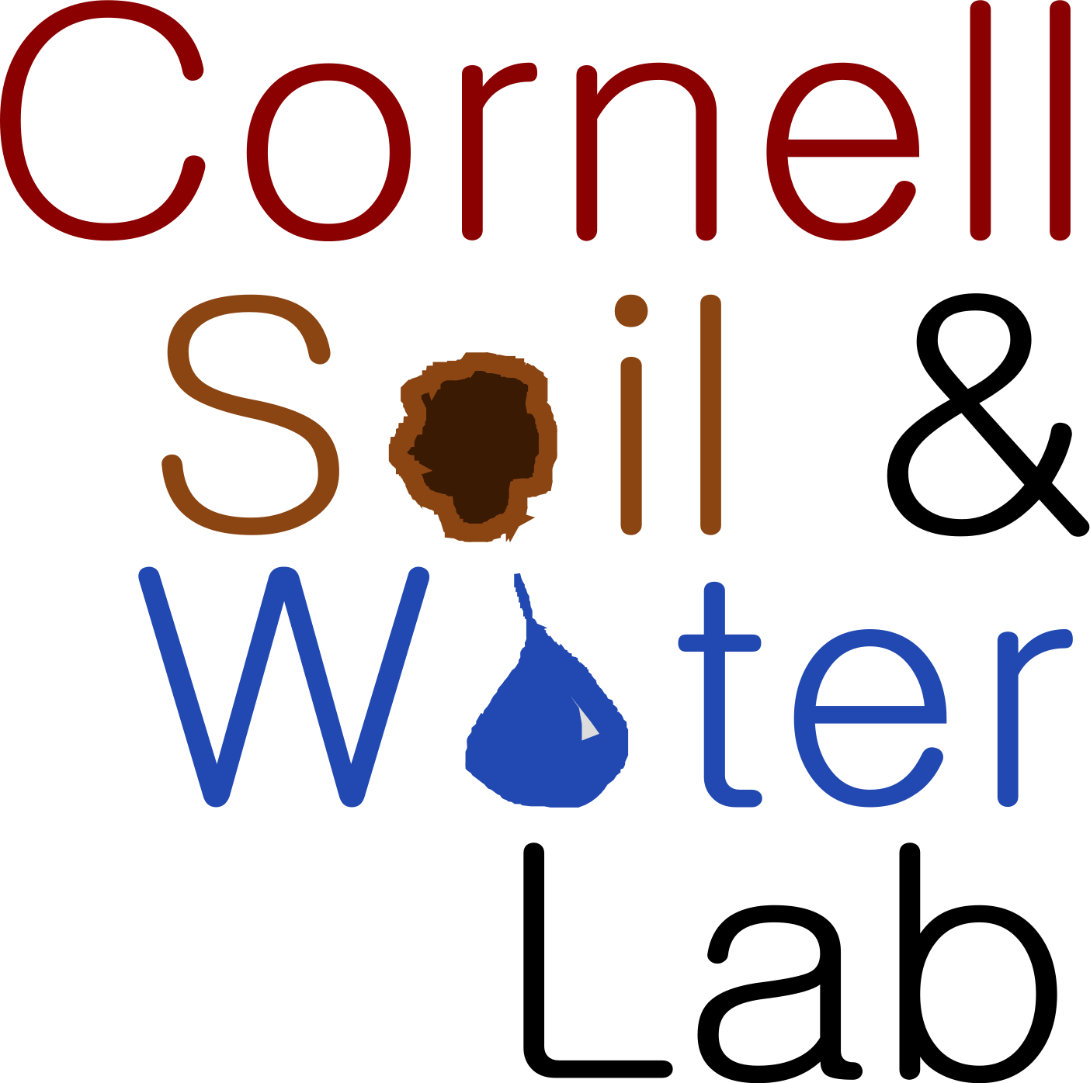
Inexpensive, Open-Source, Internet of Things-Enabled Sensing Stations for Environmental Parameter Measurements
Peter Marchetto, Kathryn Hofmeister, and M. Todd Walter
Soil and Water Lab, Cornell University

Slide 2
Do what now?!
Inexpensive
Open-Source
Internet of Things
Sensing Stations
Environmental Parameters
Measurements

Slide 3
Why?
USGS Network
Only Depth (and Sometimes Temp.)
Decreasing Number
Preferential to Large Water Bodies and Signals
Multiple Parameters
Depth (and Q)
Conductivity (Salinity)
Temperature
Turbidity (Suspended Solids)

Slide 4
How?
Phase 1: Standalone Unit
Internal development and deployment
Phase 2: Networked Nodes
Internal and external development and builds

Slide 5
How?
Design and build prototype
Document design for manufacture
Lead build workshop of interested environmental and maker groups
Deploy and calibrate sensing station(s)
Reconvene groups to discuss and revise design
Lather, rinse, repeat (wipe hands on pants)

Slide 6
How?
Sensors:

Slide 7
Phase 1

Slide 8
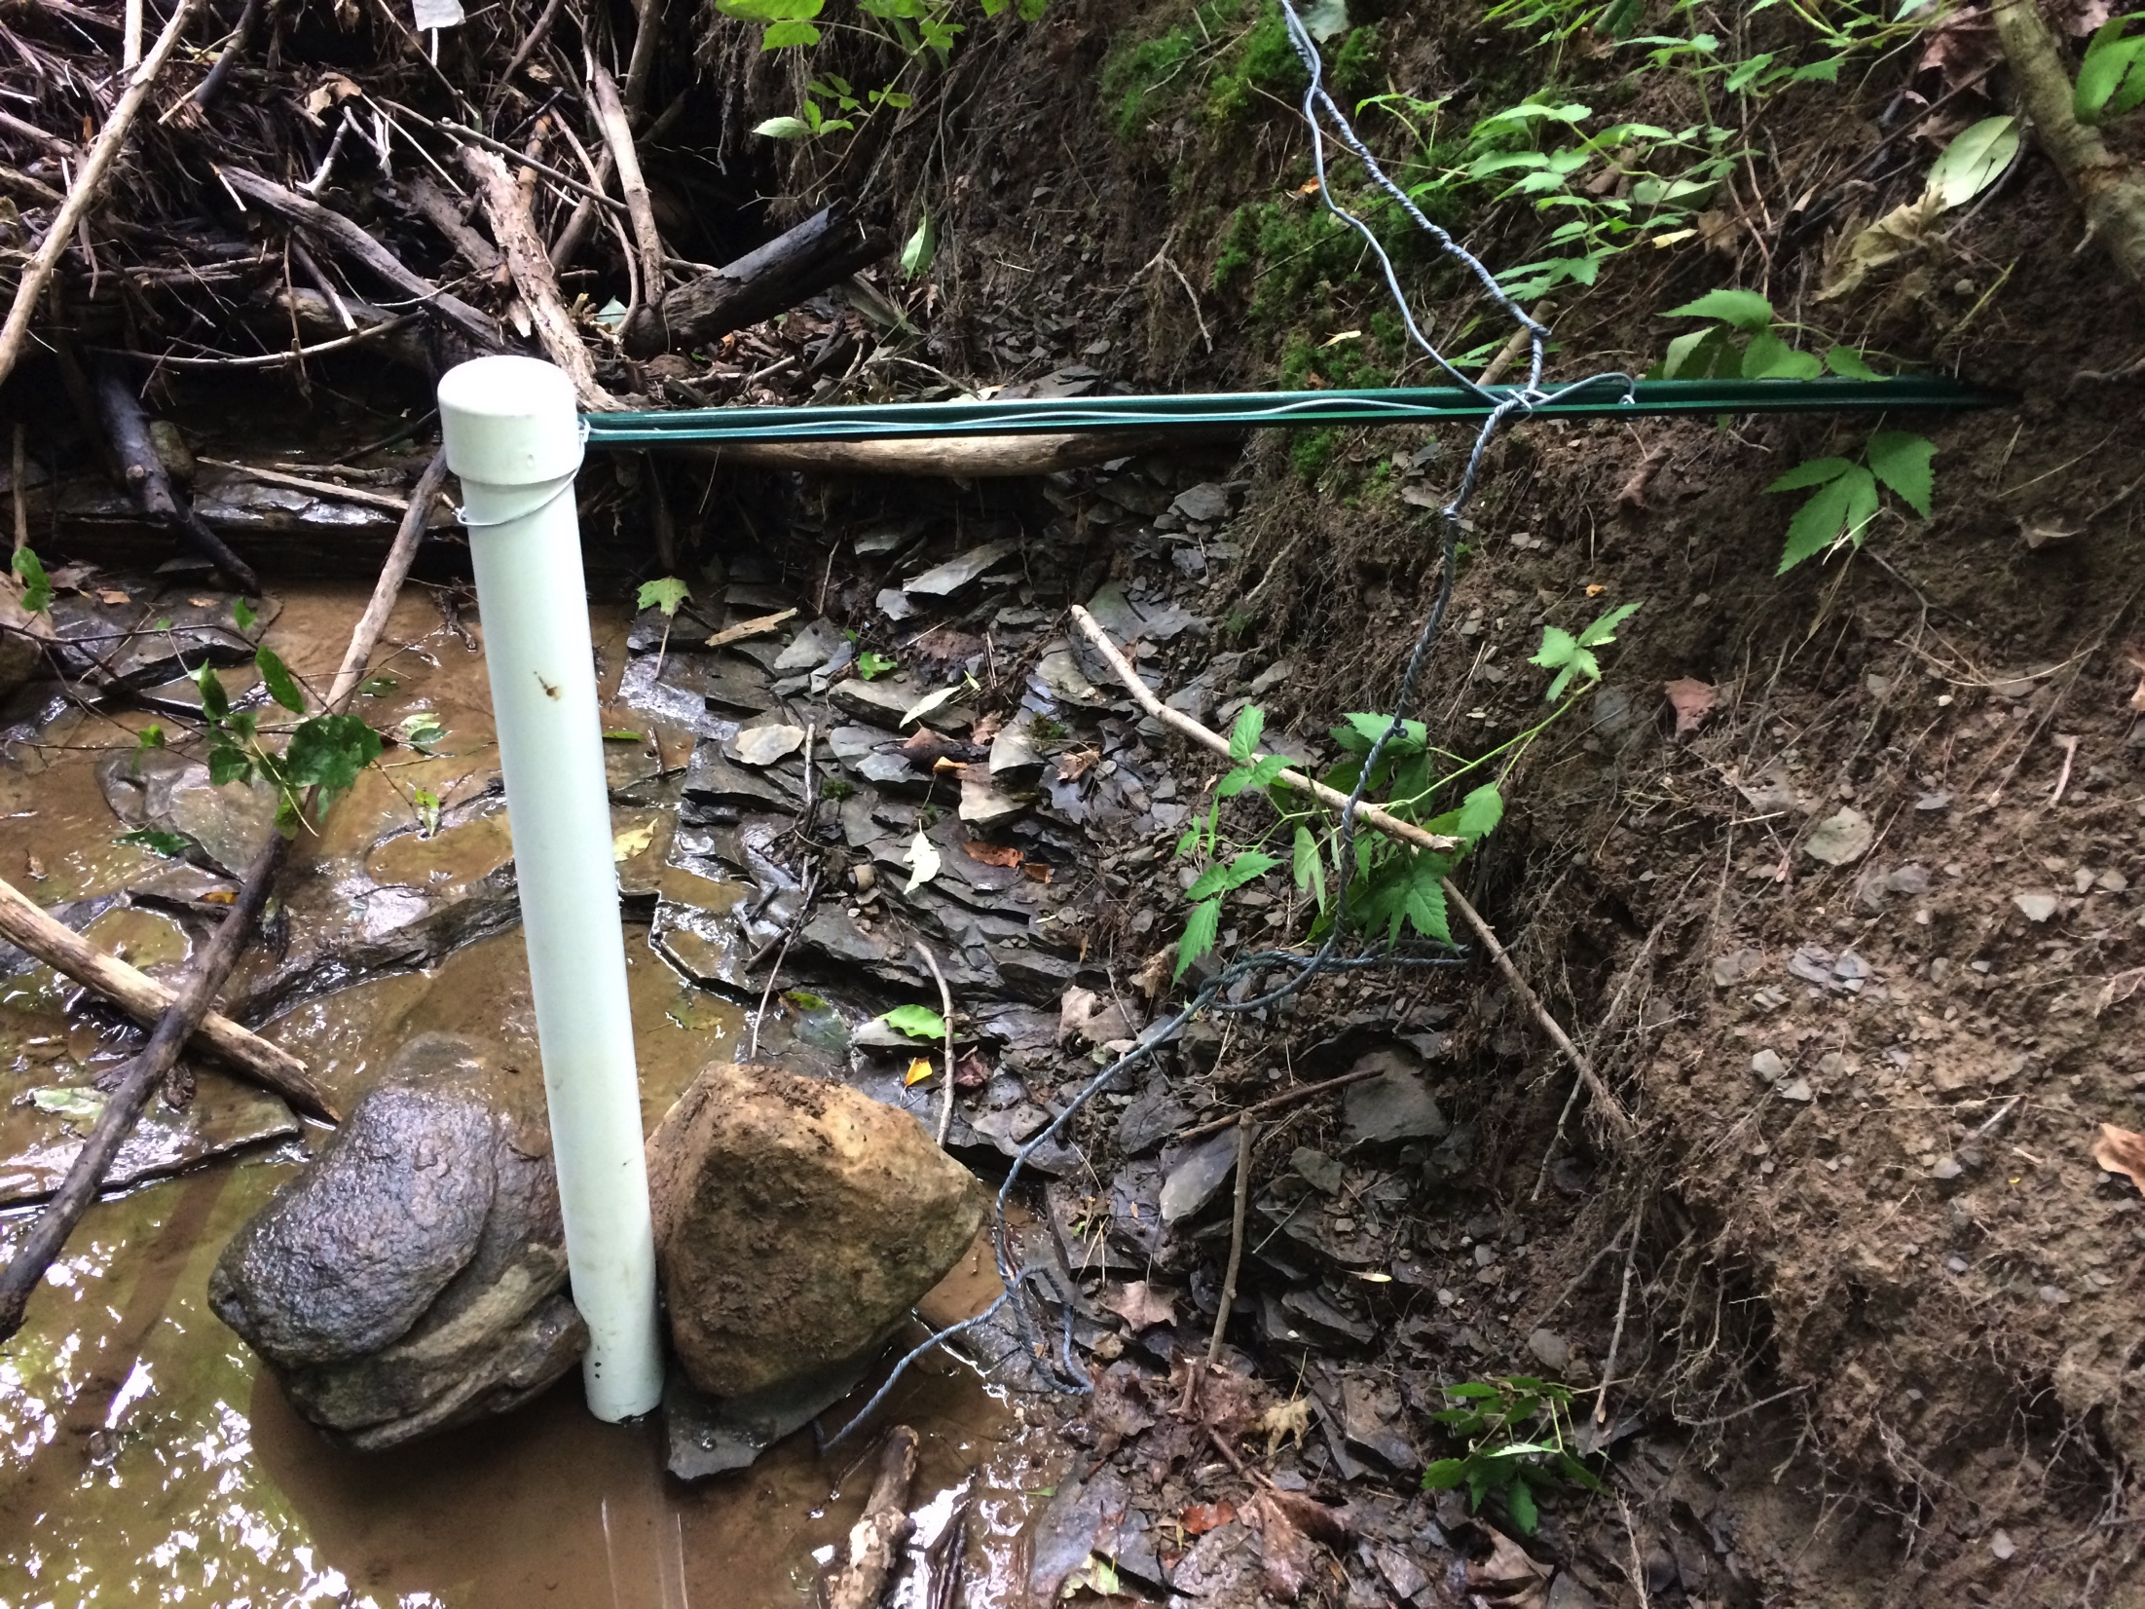
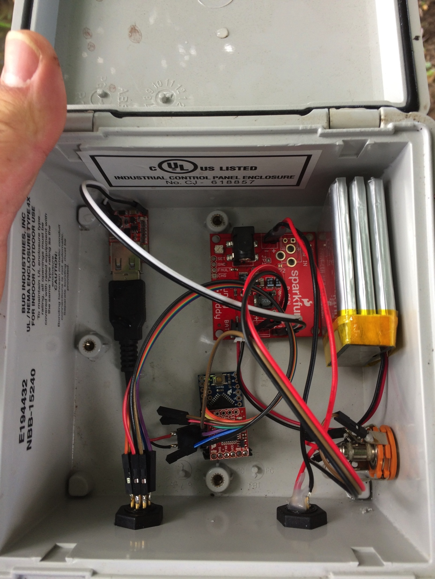
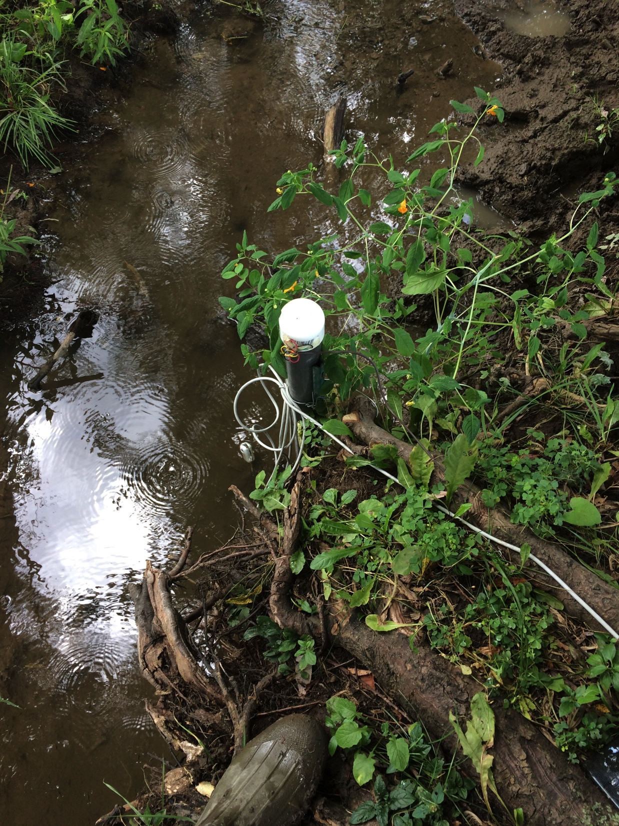
Phase 1

Slide 9
Phase 1 Results

Slide 10
Phase 1 Lessons Learned
Don’t trust cows.
Tiny solar panel is too tiny.
µSD cards are too darn small for field work.
Raccoons like screwing with your instrumentation.

Slide 11
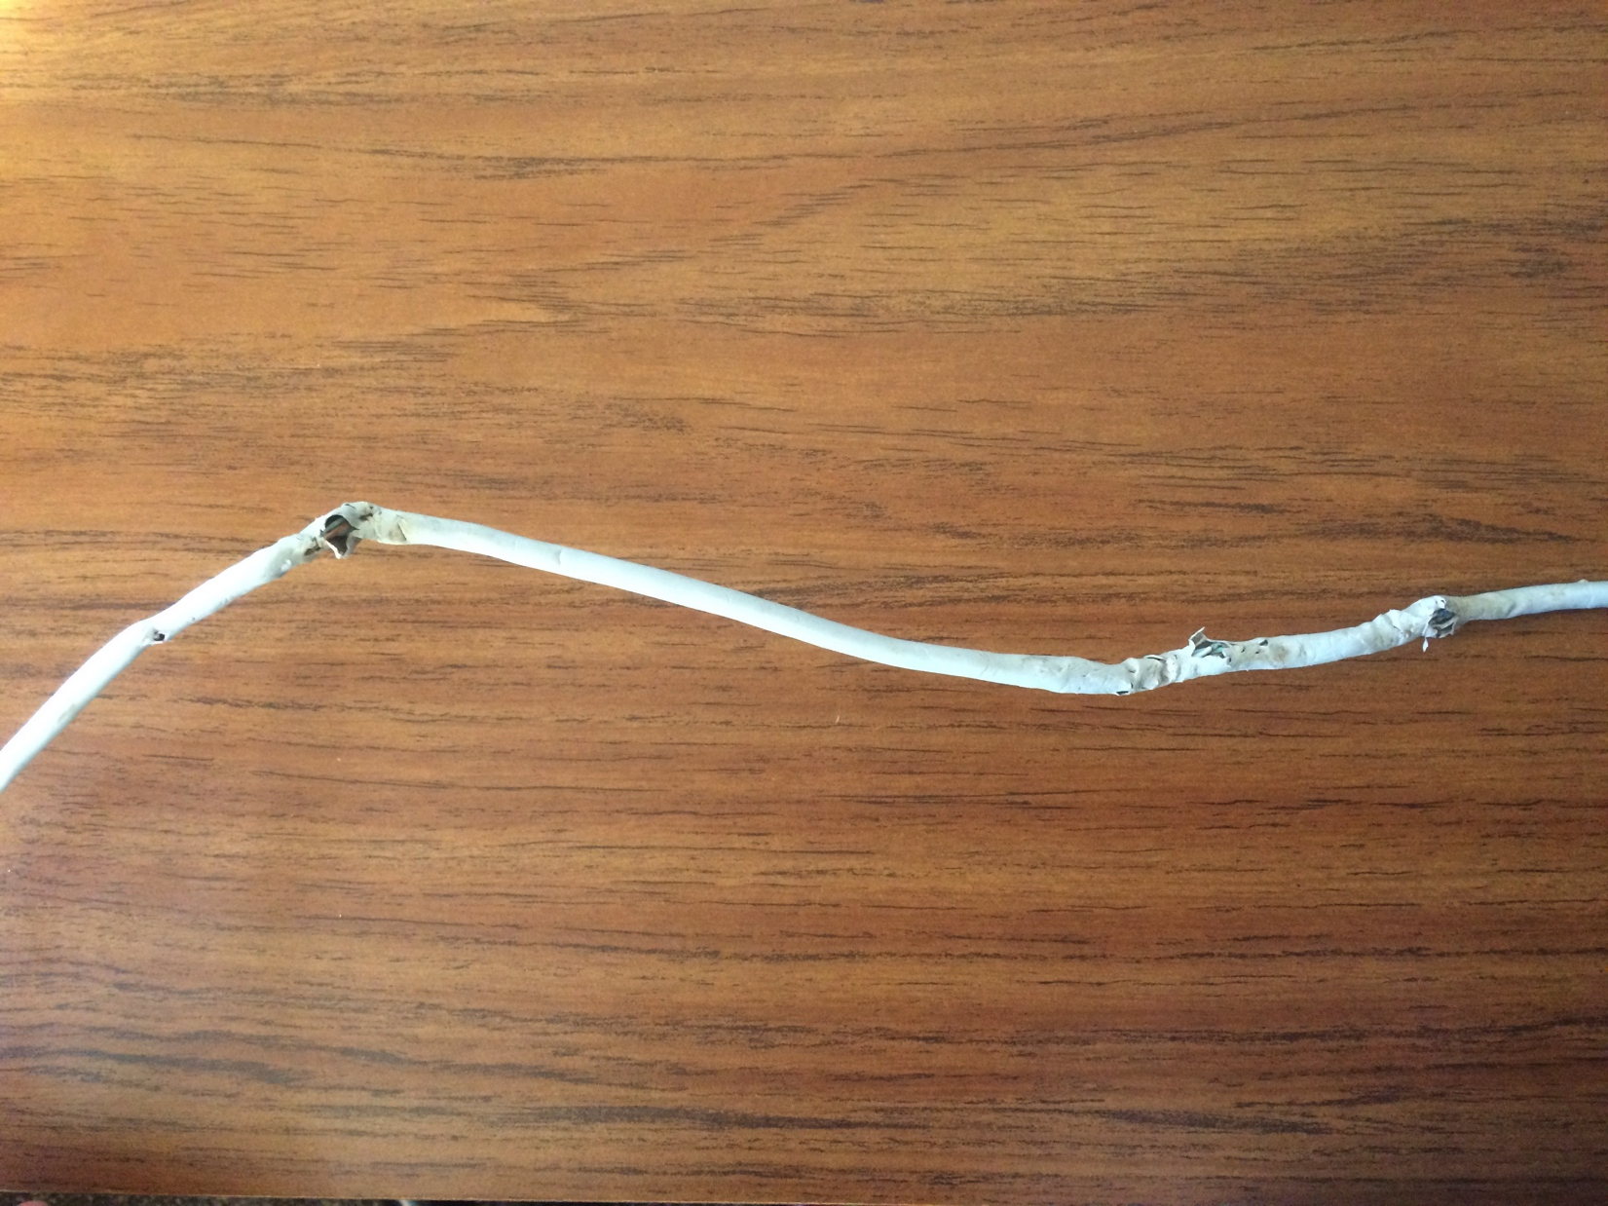
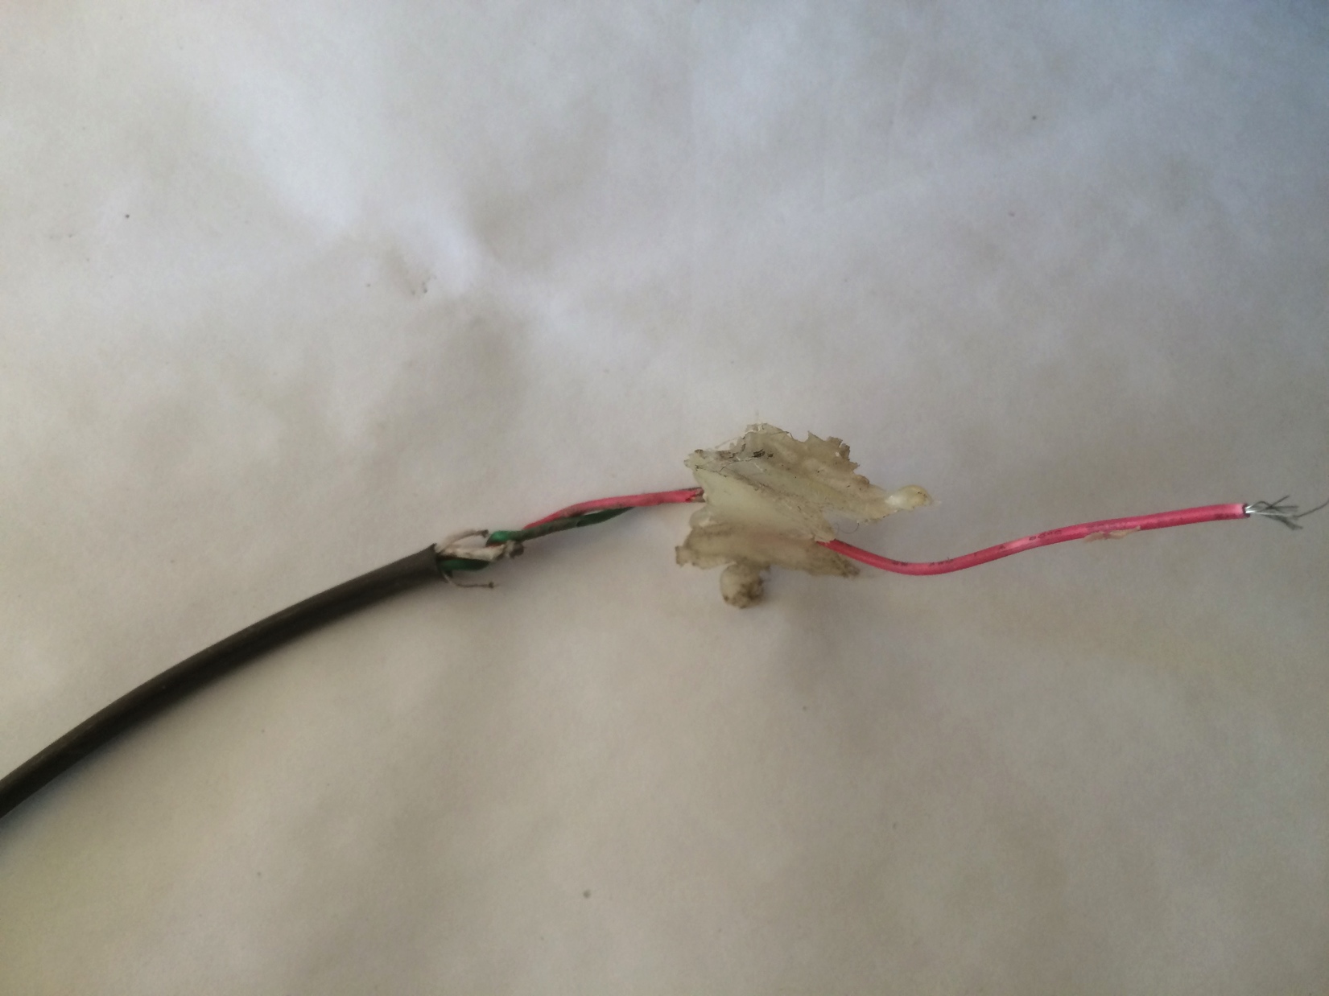
COWS!

Slide 12
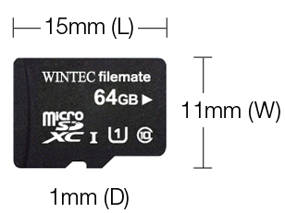
Phase 1 Lessons Learned
Don’t trust cows.
Tiny solar panel is too tiny.
µSD cards are too darn small for field work.
Raccoons like screwing with your instrumentation.
from http://www.wintecind.com/

Slide 13
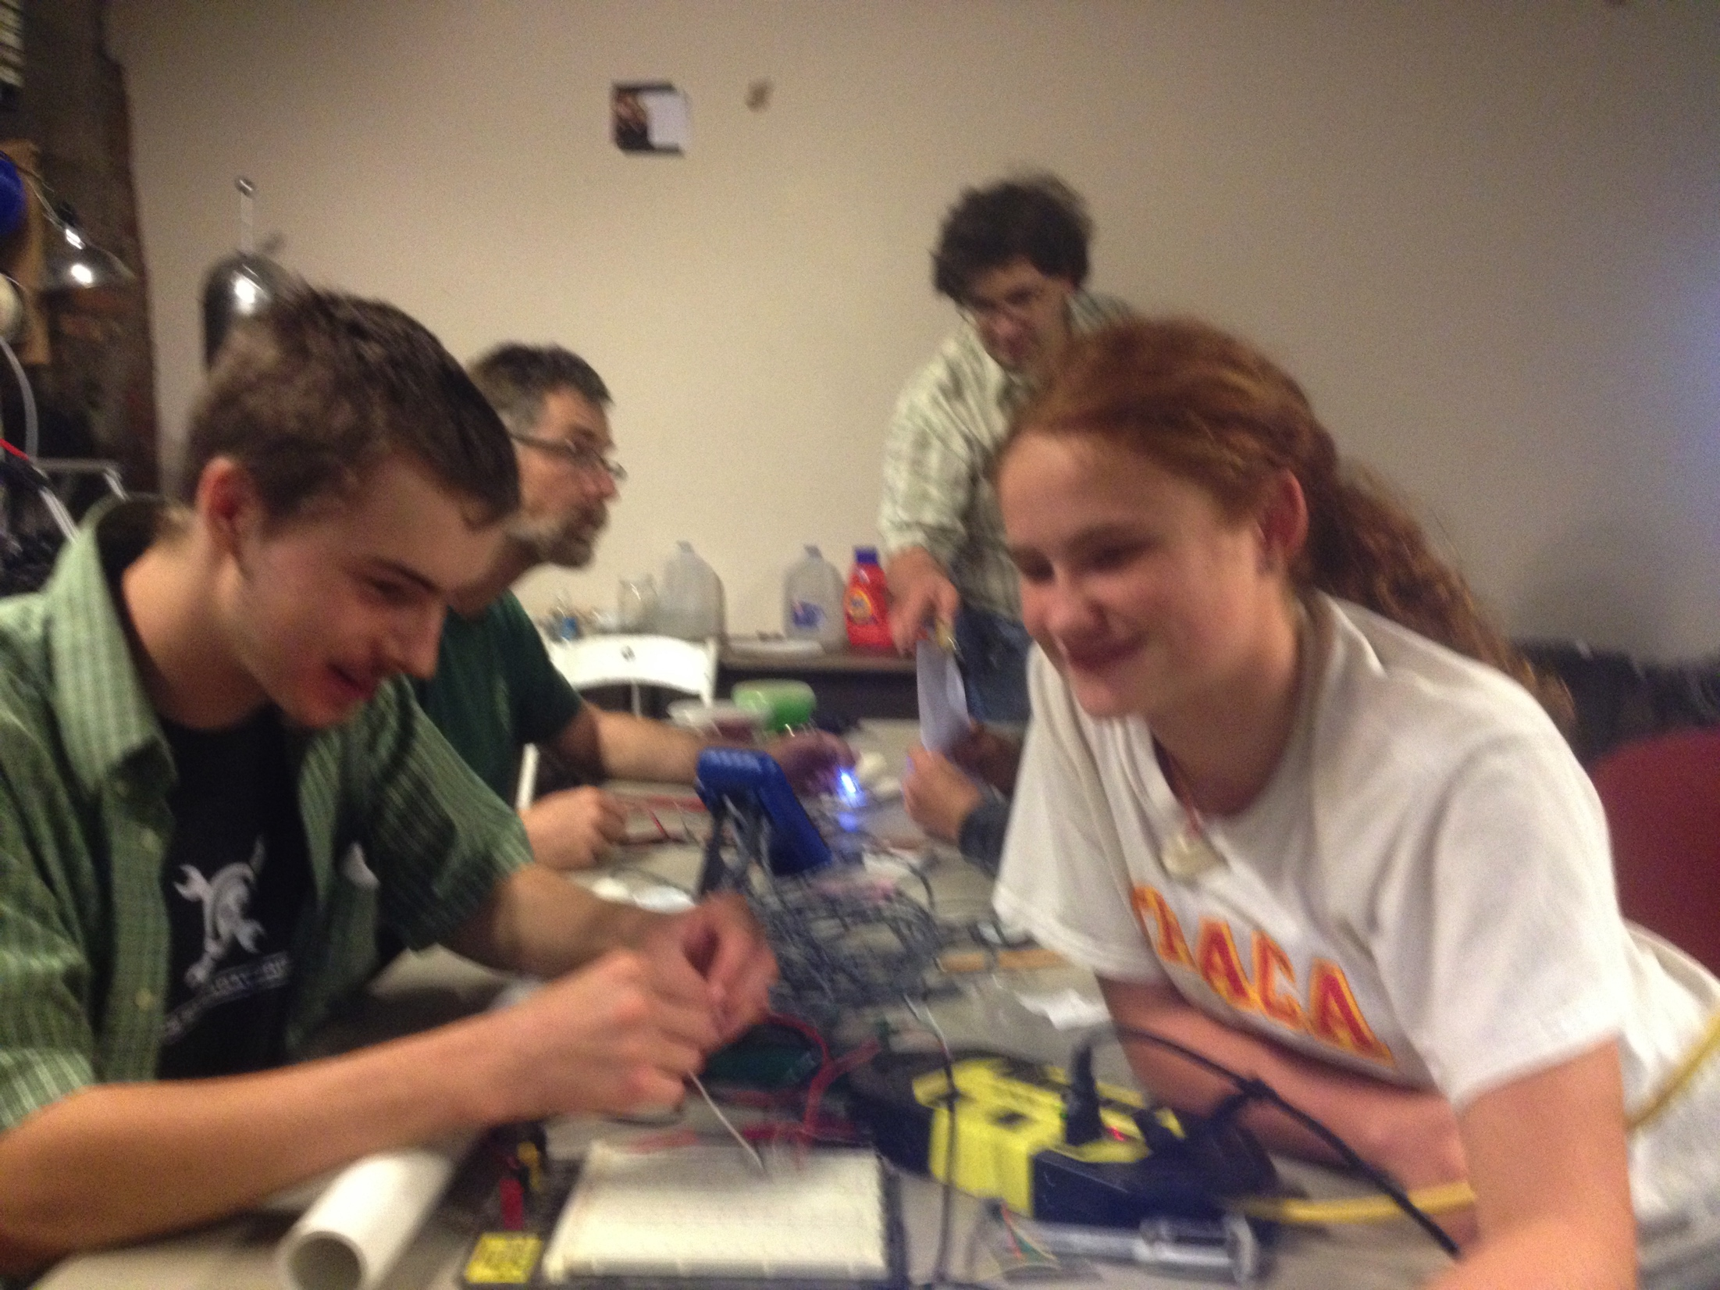
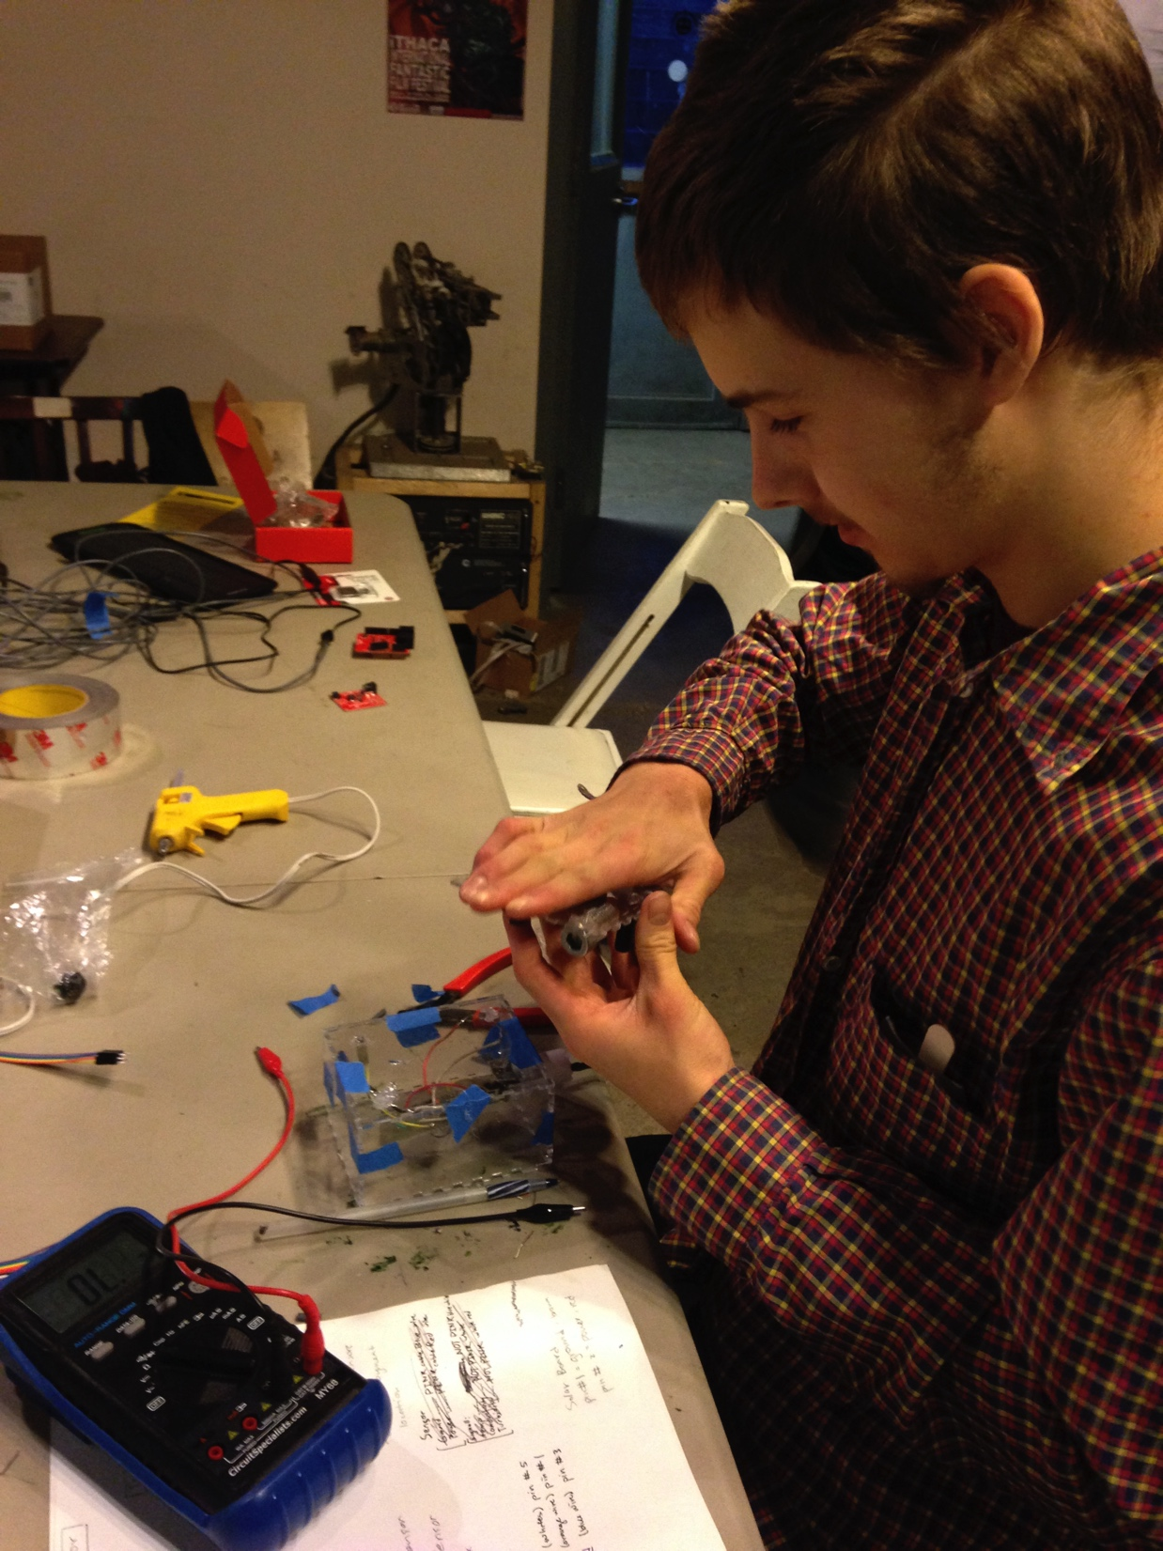
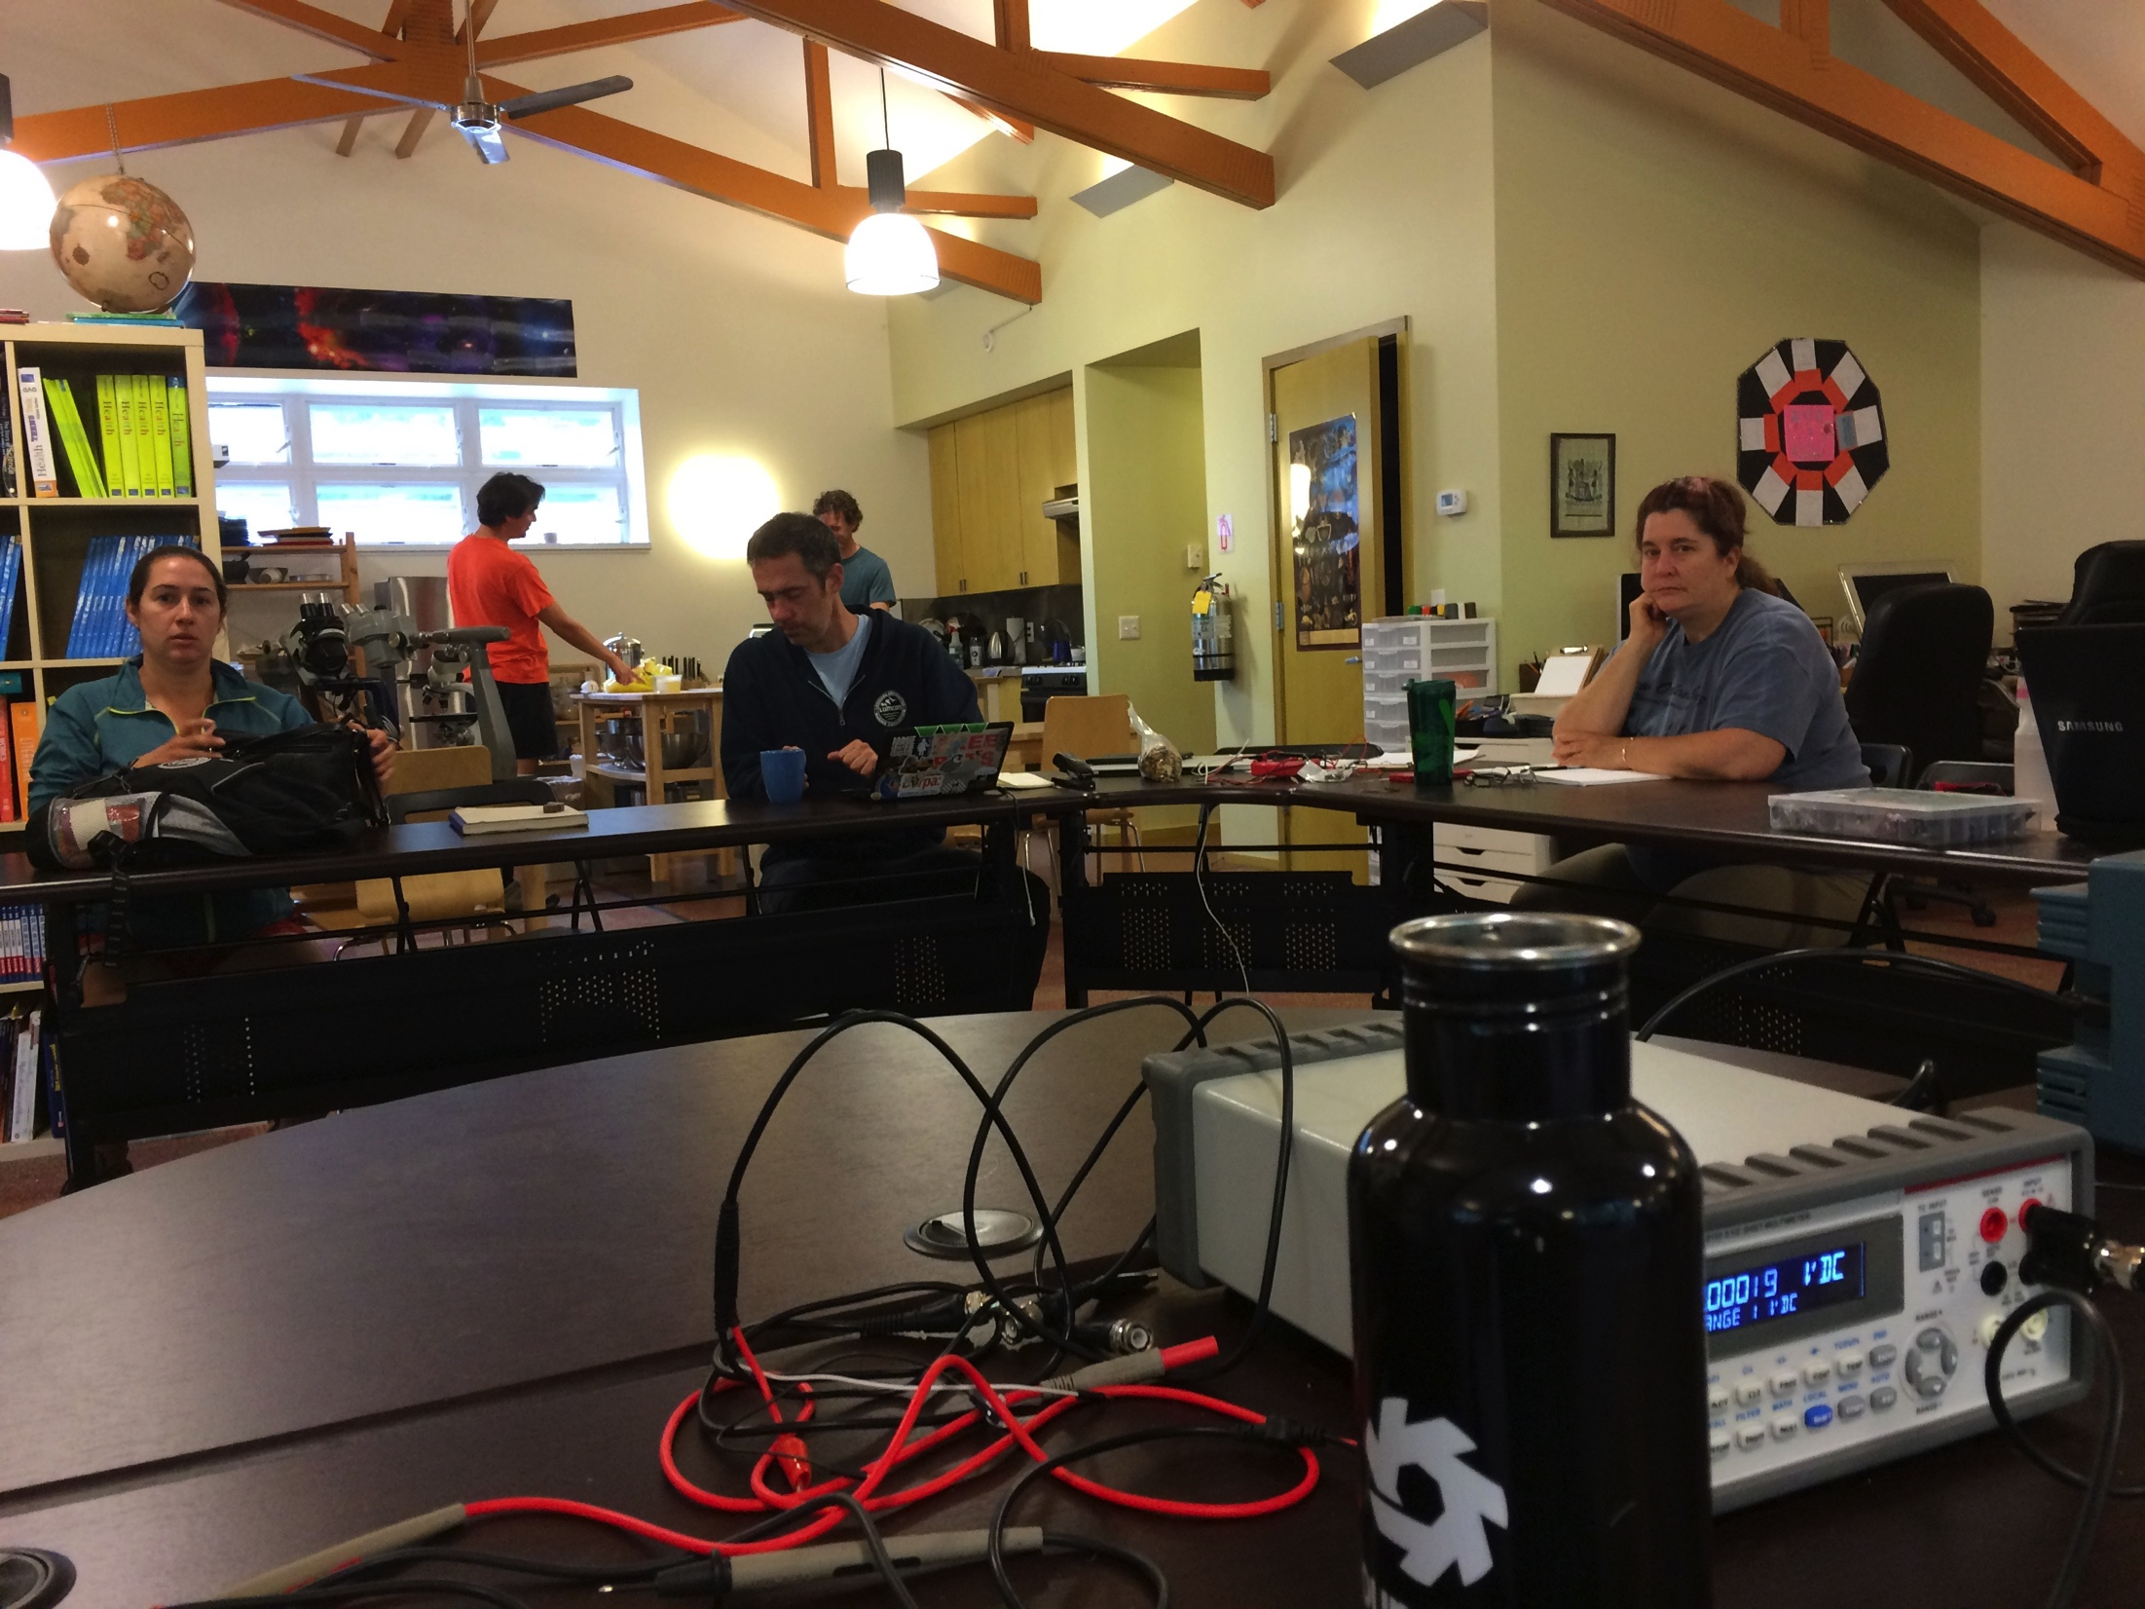
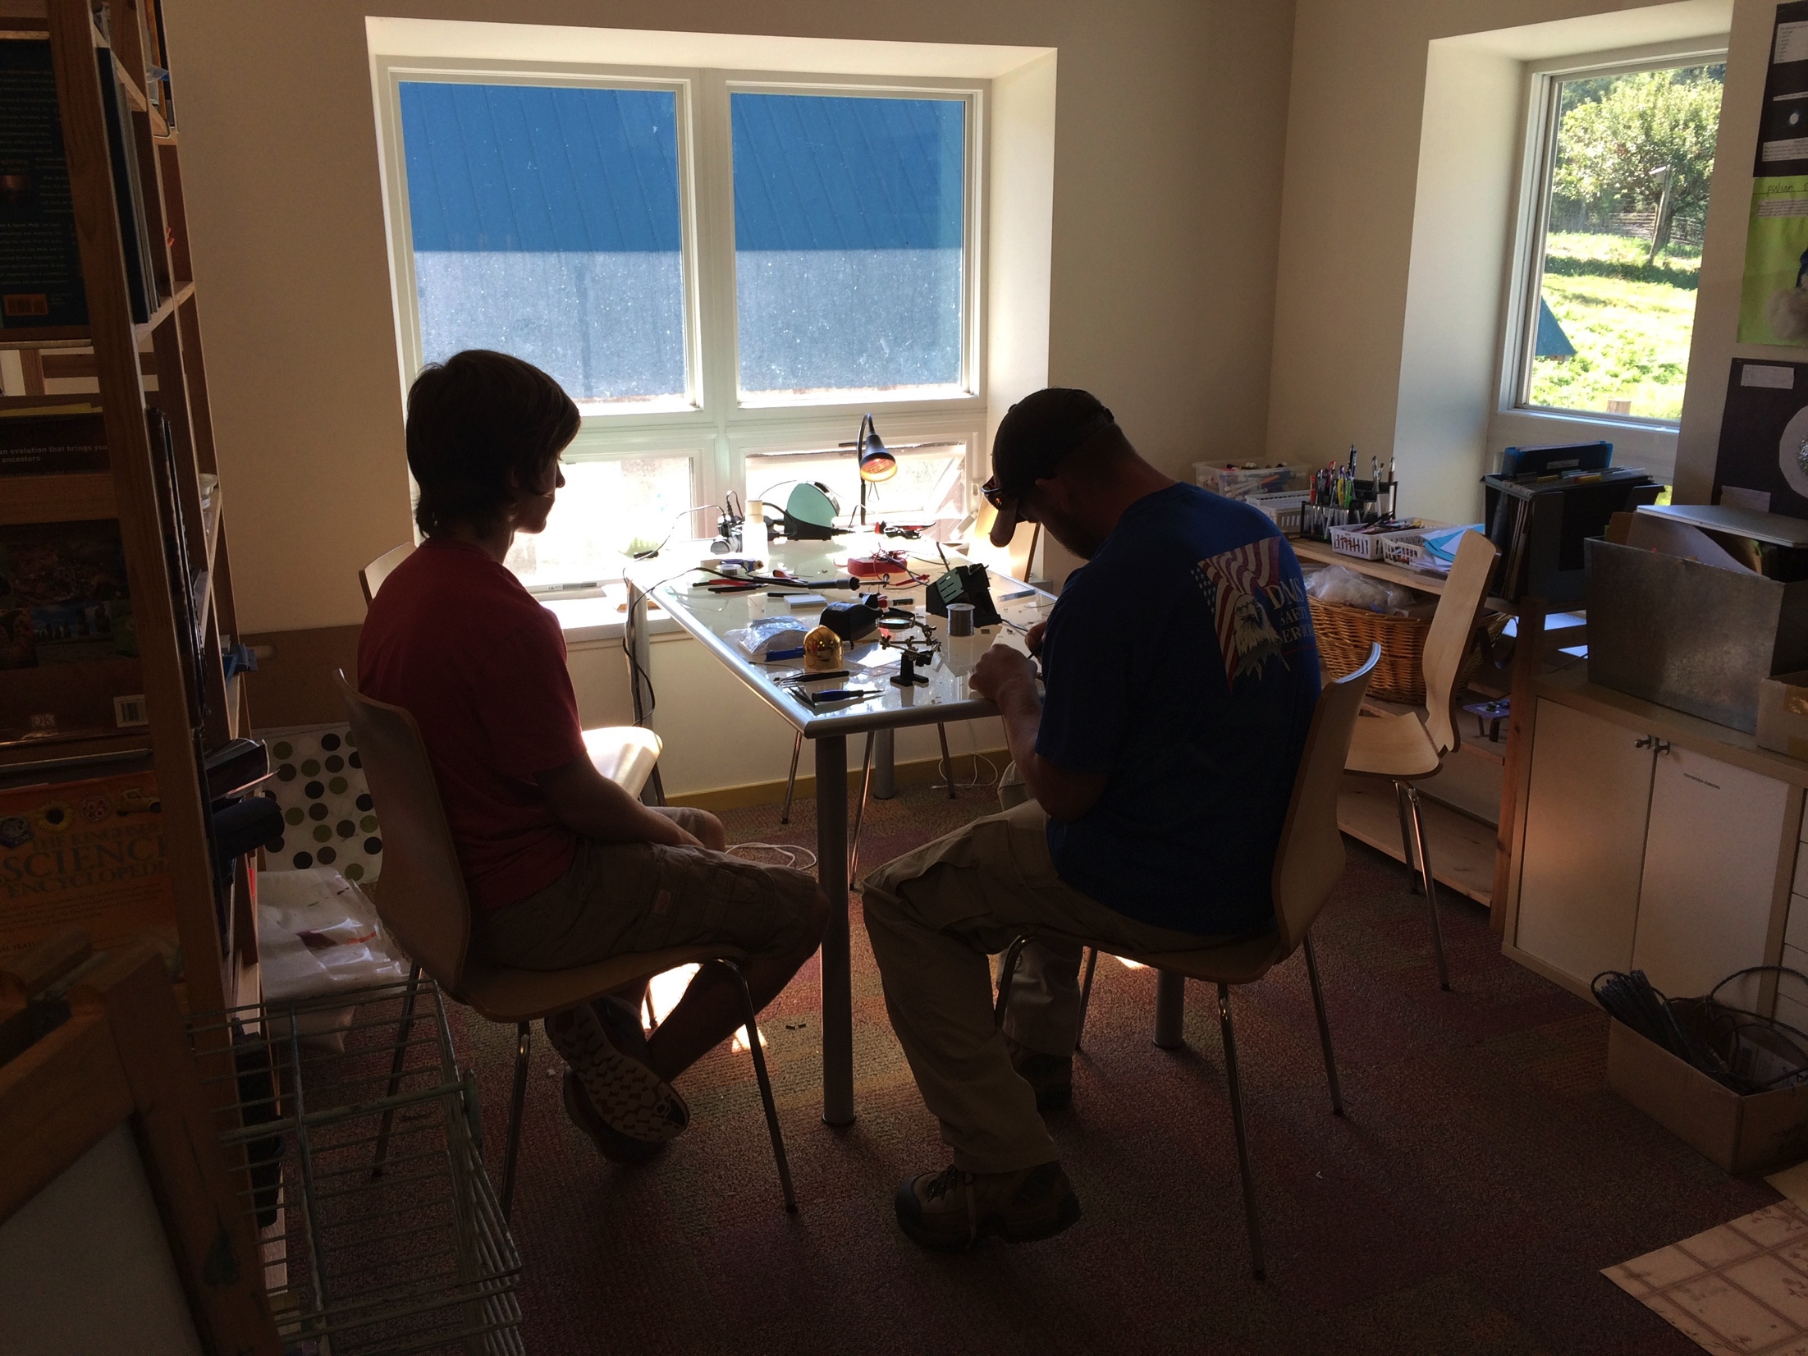
Phase 2

Slide 14
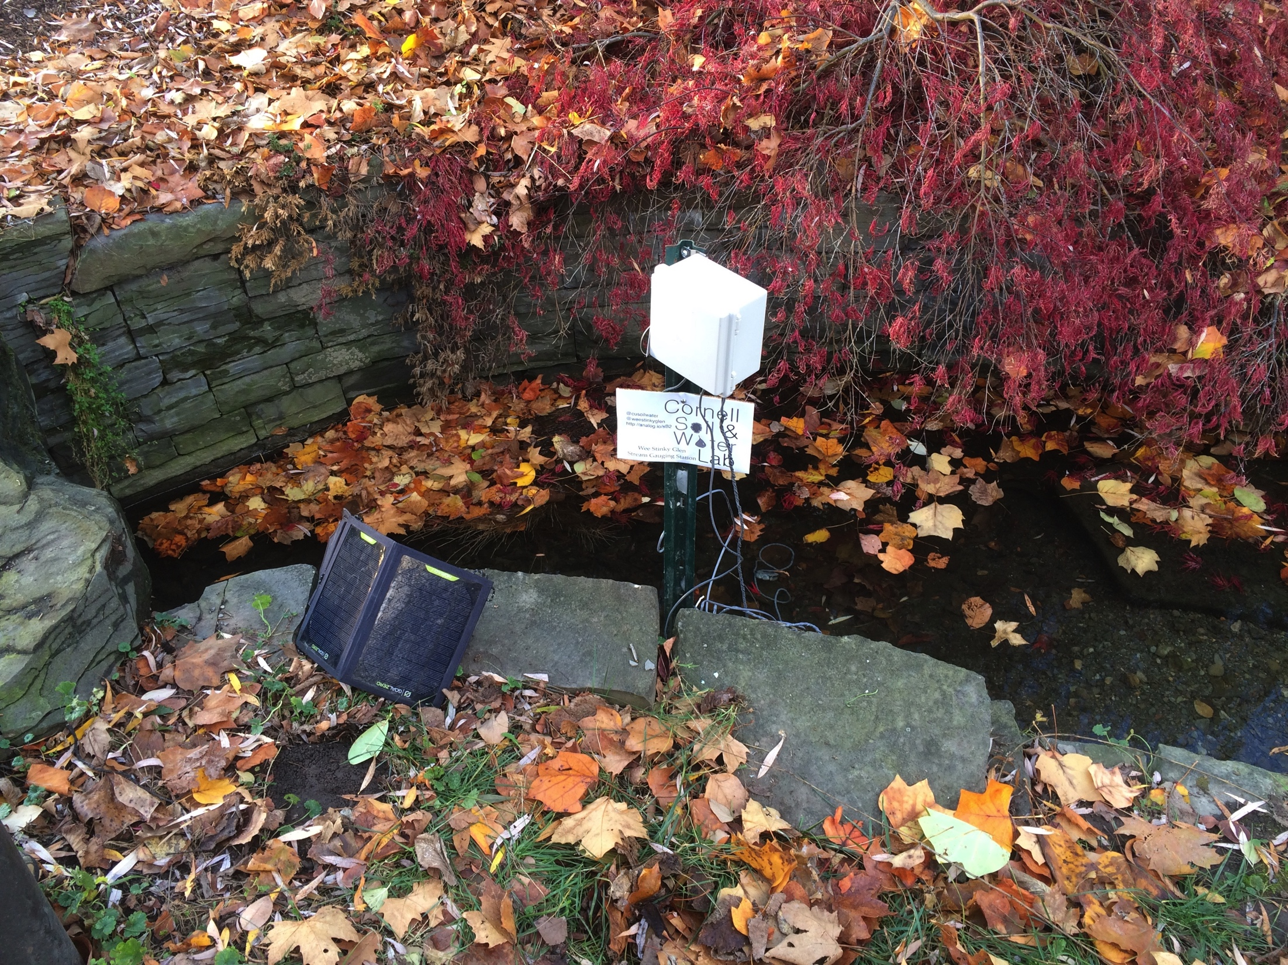
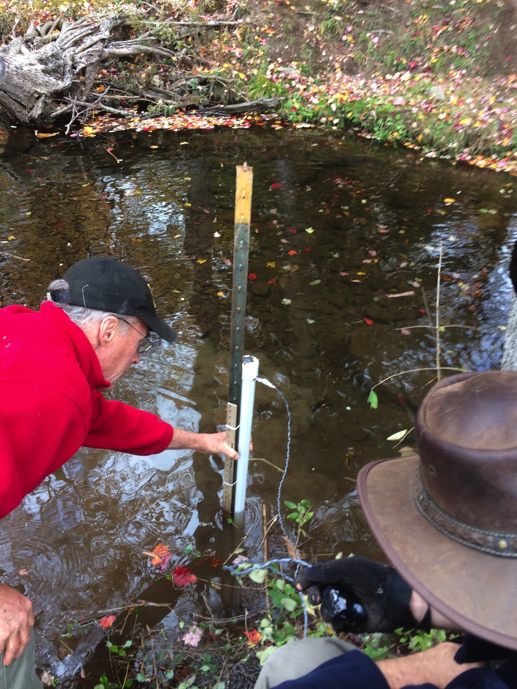
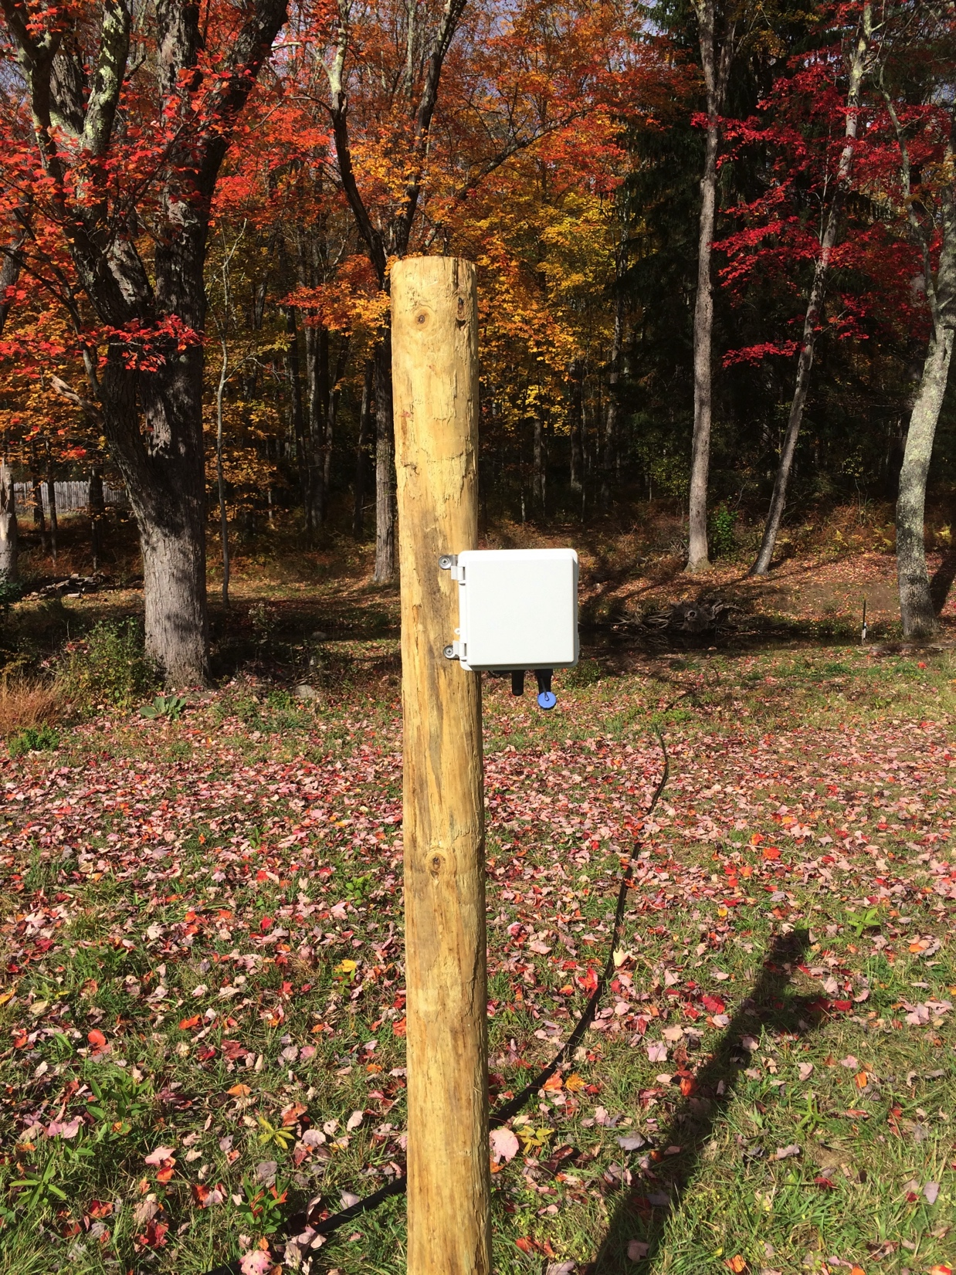
Phase 2

Slide 15
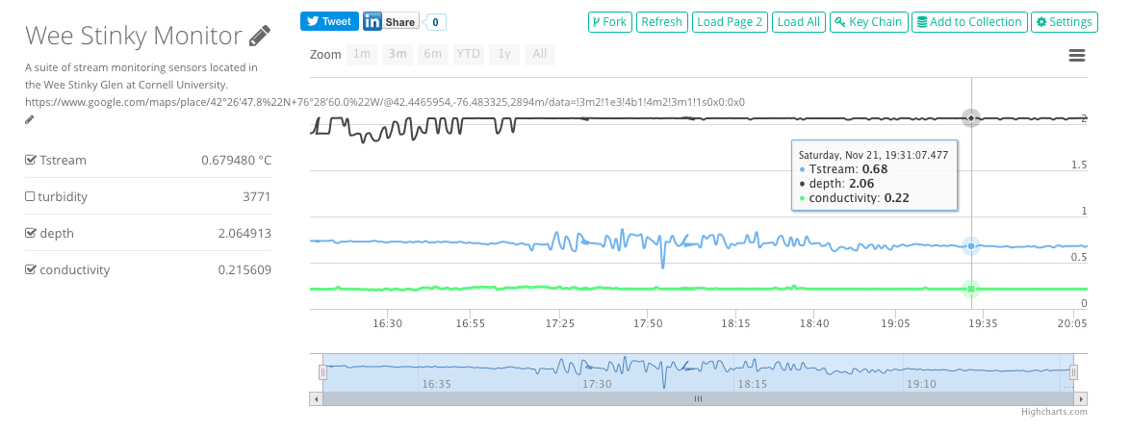
Phase 2
@weestinkyglen
http://analog.io/sB2

Slide 16
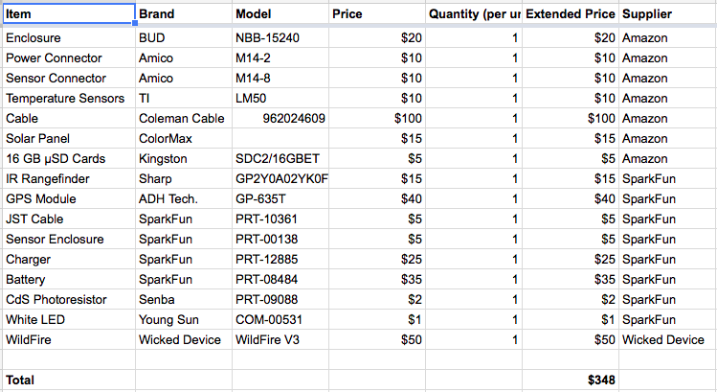
Phase 2
$348

Slide 17
Conclusions
It works!
Design is scalable.
You should do it, too!
http://bit.ly/CornellStream

Slide 18
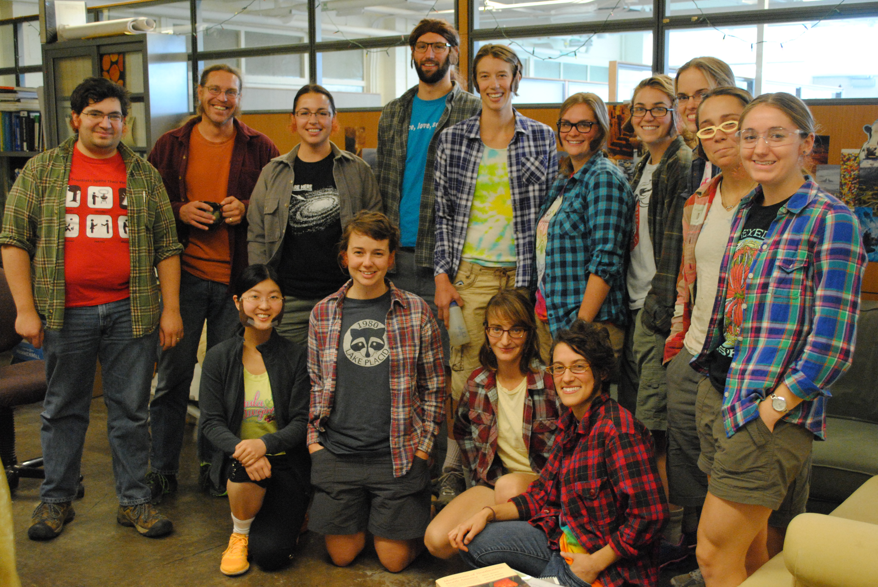
Acknowledgements
http://bit.ly/CornellStream
Everyone in the Soil and Water Lab
Chelsea Morris
Lauren McPhillips
Keiran Cantillina
Tompkins County 4-H2O Club
The Homestead School
Public Lab
Water Defense
SRBC

